Slide 1




Post Graduate Program in Data Science and Engineering
CAPSTONE PROJECT
LOAN DEFAULT PREDICTION
Under the guidance of Mr. Animesh Tiwari
Submitted By:Group-01
3NJZ6RGL7W
ANANNYA SINGH
WX2EE50531
HARISH RAYA
VT8ZPRQXLM
PRIYANSHU SHARMA
FQXYSGA75
SANNIDHI HARSHA VEENA
PVLWKE0CT4
VAISAKHI RAMESH

Slide 2

PROBLEM STATEMENT
TVS Credit faces significant challenges due to rising loan defaults, with a 2.2% overall default rate in FY2022 (CRISIL) and a sharp increase to 5.7% for sub-investment grade loans in FY2024 (India Ratings), while premium loans above ₹75 lakh saw a 3.01% delinquency rate as of Dec 2020. This leads to financial losses for lenders, hinders access to credit for future borrowers, and disrupts the overall financial system's stability. We built a model to predict loan defaulters and identify key features contributing to defaults on unseen data. This model aids in mitigating the risk of defaults, thereby helping financial institutions make more informed lending decisions.
1

Slide 3

















CRISP-DM METHODOLOGY
Cross Industry Standard Process of Data Mining
Business Understanding
Data Understanding
Data Preparation
Modelling
Evaluation
Deployment
2

Slide 4
DATA DESCRIPTION
V1 | Customer ID | V11 | No of advance EMI paid | V23 | Sanctioned amount in the secured Loans
V2 | Customer bounced first EMI (1 : Yes, 0 : No) | V12 | Rate of interest | V24 | Sanctioned amount in the unsecured Loans
V3 | Number of times bounced in recent 12 months | V13 | Gender (Male/Female) | V25 | Maximum amount sanctioned
V4 | Month of business with TVS Credit | V14 | Employment type (HOUSEWIFE : housewife, SELF : Self-employed, SAL : Salaried, PENS : Pensioner, STUDENT : Student) | V26 | Time since last Personal loan taken (in months)
V5 | Number of times bounced while repaying the loan | V15 | Resident type of customer | V27 | Time since first consumer durables loan taken (in months)
V6 | EMI | V16 | Date of birth | V28 | Number of times 30 days past due in last 6 months
V7 | Loan Amount | V17 | Age at which customer has taken the loan | V29 | Times 60+ Days Past Due (6 Mo.)
V8 | Tenure | V18 | Number of loans V19: Secured,V20:Unsecured | V30 | Times 90+ Days Past Due (3 Mo.)
V9 | Dealer codes | V21 | Maximum amount sanctioned in the Live loans | V31 | Customer’s geographical location
V10 | Product code(MC : Motorcycle , MO : Moped, SC : Scooter) | V22 | Number of new loans in last 3 months | V32 | Target variable ( 1: Defaulters / 0: Non-Defaulters)
3

Slide 5










EXPLORATORY DATA ANALYSIS
NUMERICAL COLUMNS
CATEGORICAL COLUMNS
TYPE CONVERSION
SHAPE
DUPLICATES
ROWS:119528
COLUMNS:32
No Duplicates
21
9
5(int to object)
4

Slide 6







V15,V11,
V16,V14,
V12,V17,
V10,V9,
V8,V6,V5,V4,V13
V25
12%
V21
28%
V27
69%
V23
82%
V24
83%
84%
V26
Removed missing values more than 30% for rows and columns.
88%
MISSING VALUES PERCENTAGE
5

Slide 7
V11,V5
V20,V18,
V30
5%
V9
9%
11%
V19
V2,V3,
V4,V8,
V12,V21,
V23,V24,
V26,V27,
V29
13%
V28
15%
19.79%
Capping the Outliers with lower limit 5% and upper limit 95%.
28%
OUTLIERS PERCENTAGE
6

Slide 8
VARIANCE INFLATION FACTOR
(Before Feature Engineering)
FEATURES | VIF
V7, V8, V6, V4, V25, V28, V29, V30, V12, V19, V17 | > 10 (High Multicollinearity)
No Columns | Between 10 and 5 (Moderate Multicollinearity)
V20, V9, V5 | Between 5 and 1 (Low Multicollinearity)
7

Slide 9
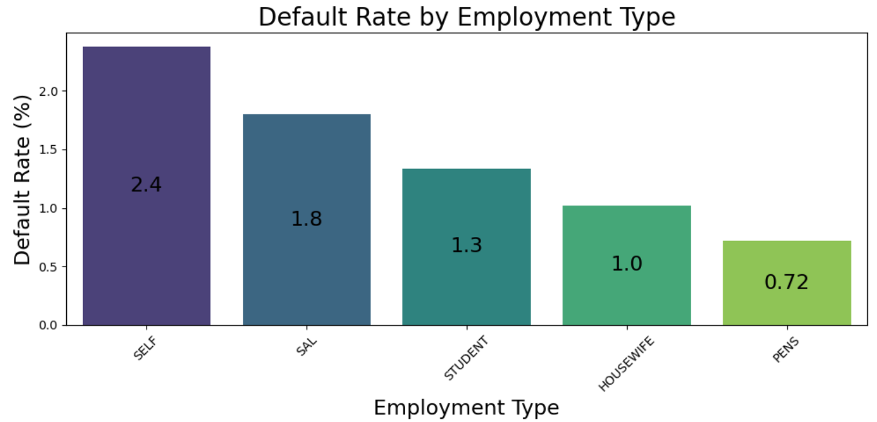
EMPLOYEMENT TYPE HAVING HIGHEST
PERCENTAGE OF DEFAULTERS
Self-employed individuals have the highest default rate (2.38%).
Pensioners and housewives, with lower default rates.
Default rates by group: SELF (2.38%), SAL (1.80%), HOUSEWIFE (1.02%), PENS (0.72%), STUDENT (1.34%).
8

Slide 10
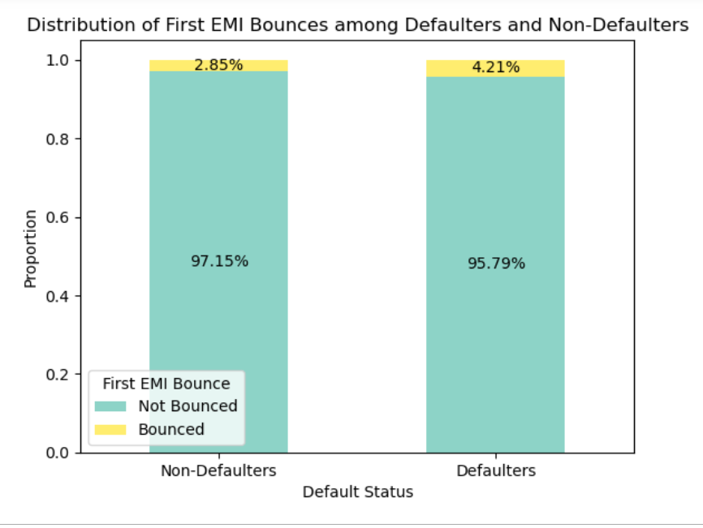
FIRST EMI BOUNCE CORRELATES WITH LOAN DEFAULT LIKELIHOOD.
The first EMI bounce rate is significantly higher for defaulters (4.207%) compared to non-defaulters (2.85%)
9

Slide 11
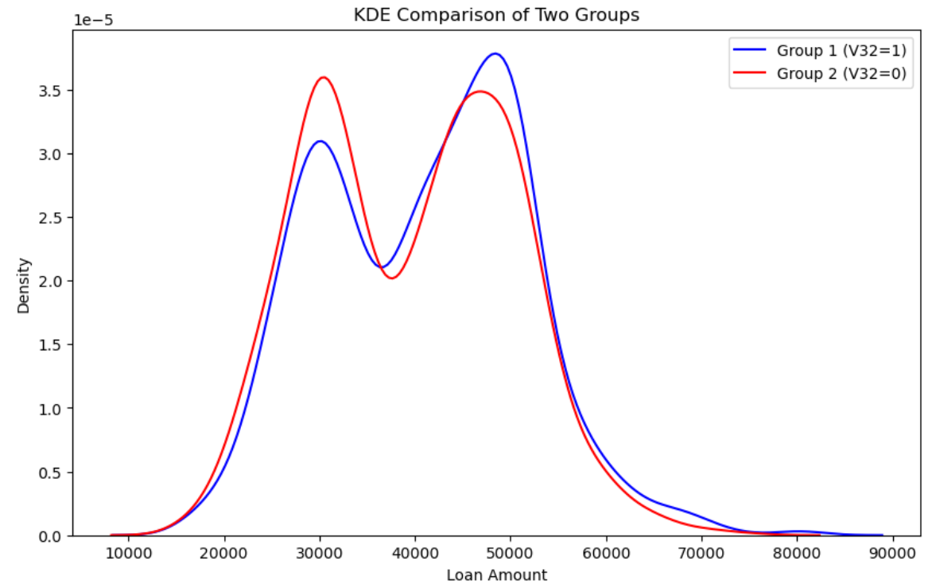
LOAN AMOUNT AND TARGET
Two groups, each consisting of 1500 samples, were created from each class label, including Loan Amount. These groups were then compared to examine their distributions.
Test
Mann-Whitney U Test (for Two Independent Groups)
Data is not normally distributed(Shapiro)
Data have equal Variance
(Levene)
Result
U statistic:1197485.5
p-value: 0.002244
alpha=0.05
As the p value <= Level of significance
Distribution for both group are different
Conclusion
Loan Amount is a SIGNIFICANT variable to predict Target .
10

Slide 12
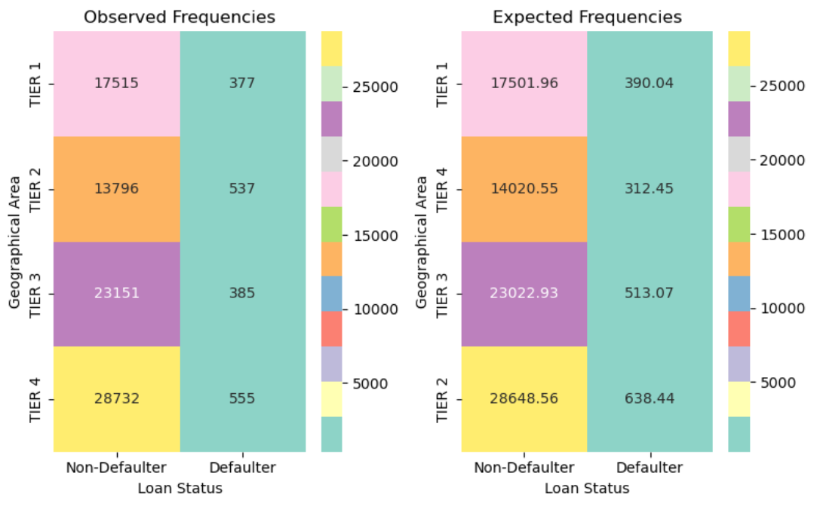
GEOGRAPHICAL AREA AND TARGET
Two groups, each consisting of 1500 samples, were created from each class label, including Loan Geographical Area. These groups were then compared to examine their distributions.
Test
Chi-Square Test (for two categorical variables)
Result
Chi2 statistic: 209.246813
P-Value: 4.23e-45
alpha=0.05
As the p value < Level of significance
There is association between the two columns
Conclusion
Geographical area is a SIGNIFICANT variable to predict Target.
11

Slide 13
HYPOTHESIS TESTING
Category/Numerical | Variable Name | p-value | Significant | Category/Numerical | Variable Name | p-value | Significant
Numerical | Customer has bounced in first EMI | 9.724173e-02 | Not Significant | Numerical | Rate of interest | 9.019174e-01 | Not Significant
Numerical | No of times bounced 12 months | 5.870829e-23 | Significant | Numerical | Customer age when loan was taken | 3.837020e-08 | Significant
Numerical | Maximum MOB | 1.383230e-03 | Significant | Numerical | No of loans | 7.405248e-01 | Not Significant
Numerical | No of times bounced repaying loan | 4.228057e-25 | Significant | Numerical | No of secured loans | 2.615057e-01 | Not Significant
Numerical | EMI | 7.279005e-01 | Not Significant | Numerical | No of unsecured loans | 6.146654e-01 | Not Significant
Numerical | Loan Amount | 1.538868e-03 | Significant | Numerical | Maximum amount sanctioned | 4.413530e-04 | Significant
Numerical | Tenure | 6.585025e-05 | Significant | Numerical | No of times 30 days past due (last 6 months) | 2.772382e-174 | Significant
Numerical | Dealer codes of the Two wheeler | 1.053188e-04 | Significant | Numerical | No of times 60 days past due (last 6 months) | 3.925612e-135 | Significant
Numerical | No of advance EMI paid | 1.518504e-02 | Significant | Numerical | No of times 90 days past due (last 3 months) | 5.754366e-87 | Significant
Categorical | Product code | 3.697350e-17 | Significant | Categorical | Employment type | 2.023093e-08 | Significant
Categorical | Gender | 1.099245e-05 | Significant | Categorical | Resident type | 9.470916e-02 | Not Significant
Categorical | Geographical location | 4.236060e-45 | Significant
12

Slide 14


MACHINE LEARNING
MODEL
BUILDING

Slide 15

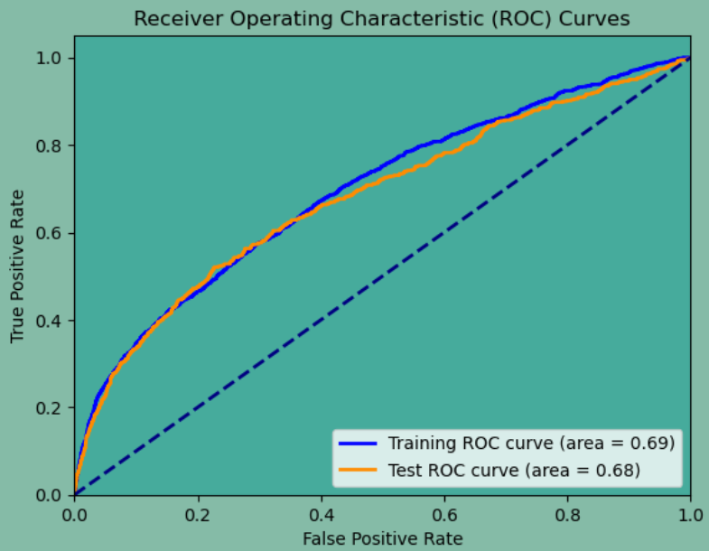
BASE MODEL EVALUATION METRICS
Test Data Performance
ROC-AUC Curve for logistic regression
Model | Accuracy | Recall | Precision | F1 Score
Naive Bayes | 0.95 | 0.16 | 0.09 | 0.11
Decision Tree | 0.96 | 0.14 | 0.12 | 0.13
Logistic Regression | 0.98 | 0.01 | 0.21 | 0.03
KNeighbors Classifier | 0.98 | 0.00 | 0.00 | 0.00
Random Forest | 0.98 | 0.01 | 0.42 | 0.03
AdaBoost | 0.98 | 0.00 | 0.00 | 0.00
Gradient Boosting | 0.98 | 0.02 | 0.33 | 0.05
XGBoost | 0.98 | 0.05 | 0.31 | 0.08
Recall and Precision are poor due to data imbalance between Defaulter and Non-Defaulter
13

Slide 16


FEATURE ENGINEERING
Total Repayment = EMI × Tenure_Months
Total Interest Paid = [Loan Amount ×Tenure ​× Rate of Interest] / 100
Total Past Due = Times 30 + days Past due(6 mo) + Times 60+ Days Past Due (6 Mo.)​ + Times 90+ Days Past Due (3 Mo.)
Repayment Risk Score = (Times 30+ days Past due(6 mo) * 2) + (Times 60+ Days Past Due (6 Mo.) * 1.5) + (Times 90+ Days Past Due (3 Mo.) * 3) + (Times bounced repaying loan *2)
Loan Burden = (Loan Amount/Tenure)​ + EMI
Default Risk Score = [Times 30+ days Past due(6 mo) + Times 60+ Days Past Due (6 Mo.) + Times 90+ Days Past Due (3 Mo.) + Times bounced repaying loan ]/4
Loan_Affordability_Index = [EMI / Rate of Interest]
14

Slide 17


FEATURE SELECTION
Tree Method (Extra Tree Classifier)
V3: Number of times bounced in recent 12 months
V9: Dealer codes from where customer has purchased the Two wheeler
V17: Age at which customer has taken the loan
V19: Number of secured loans
V20: Number of unsecured loans
Total_Interest_Paid: Total interest paid on the loan
Total_Past_Due: Total past due
LoanBurden: Monthly Loan burden
Loan_Affordability_Index: Loan affordability index (calculated
as EMI / Interest Rate)
Used Extra tree Classifier
method for feature selection and while predicting Target
on selected features using Logistic Regression provides 97.7843% accuracy.
Total features: 9
15

Slide 18
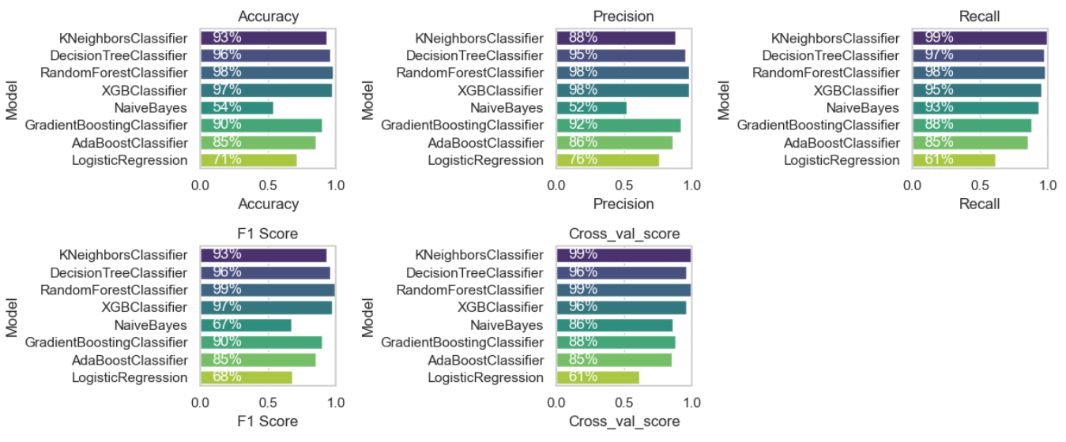


FINAL MODEL EVALUATION METRICS (SMOTE)
16

Slide 19
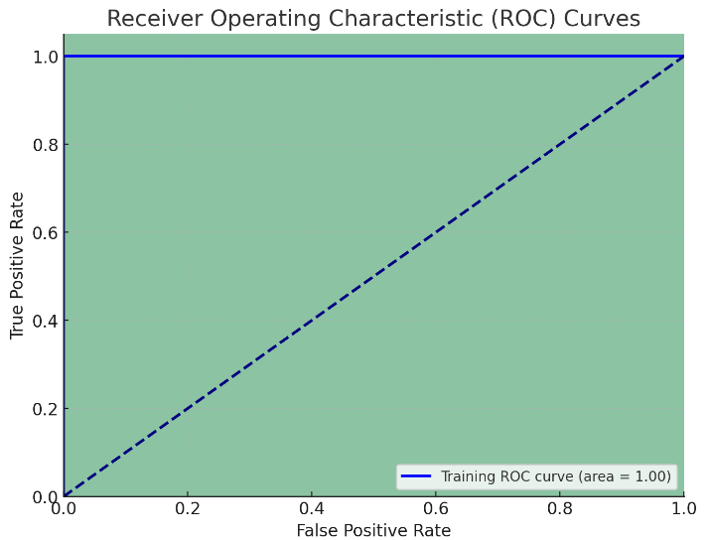
FINAL MODEL EVALUATION METRICS
(SMOTE-TOMEK )
Training Data Performance
ROC-AUC Curve for Random Forest
Model | Accuracy | Precision | Recall | F1 Score
KNeighborsClassifier | 0.95 | 0.91 | 1.00 | 0.95
DecisionTreeClassifier | 1.00 | 1.00 | 1.00 | 1.00
RandomForestClassifier | 1.00 | 1.00 | 1.00 | 1.00
XGBClassifier | 0.99 | 1.00 | 0.98 | 0.99
NaiveBayes | 0.53 | 0.52 | 0.94 | 0.67
GradientBoostingClas. | 0.90 | 0.92 | 0.88 | 0.90
AdaBoostClassifier | 0.86 | 0.86 | 0.86 | 0.86
LogisticRegression | 0.71 | 0.77 | 0.61 | 0.68
17

Slide 20
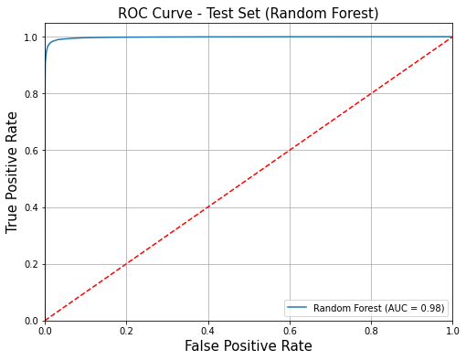
FINAL MODEL EVALUATION METRICS (SMOTE-TOMEK )
Test Data Performance
ROC-AUC Curve for Random Forest
Model | Accuracy | Precision | Recall | F1 Score
KNeighborsClassifier | 0.93 | 0.88 | 0.99 | 0.93
RandomForestClassifier | 0.98 | 0.98 | 0.98 | 0.98
DecisionTreeClassifier | 0.96 | 0.96 | 0.97 | 0.96
XGBClassifier | 0.98 | 0.99 | 0.97 | 0.98
NaiveBayes | 0.53 | 0.52 | 0.95 | 0.67
GradientBoostingClassifier | 0.90 | 0.92 | 0.88 | 0.90
AdaBoostClassifier | 0.86 | 0.86 | 0.86 | 0.86
LogisticRegression | 0.71 | 0.77 | 0.61 | 0.68
18

Slide 21
FINAL MODEL EVALUATION METRICS (SMOTENN)
Model | Accuracy (Train) | Accuracy (Test) | Precision (Train) | Precision (Test) | Recall (Train) | Recall (Test) | F1 Score (Train) | F1 Score (Test) | Cross_val_score (Train) | Cross_val_score (Test)
KNNeighbors | 0.99 | 0.97 | 0.98 | 0.96 | 1.00 | 1.00 | 0.99 | 0.98 | 1.00 | 1.00
DecisionTreeClass | 1.00 | 0.97 | 1.00 | 0.96 | 1.00 | 0.98 | 1.00 | 0.97 | 0.97 | 0.97
RandomForest | 1.00 | 0.99 | 1.00 | 0.99 | 1.00 | 0.99 | 1.00 | 0.99 | 0.99 | 0.99
XGBClassifier | 0.98 | 0.97 | 0.99 | 0.99 | 0.97 | 0.96 | 0.98 | 0.98 | 0.97 | 0.97
NaiveBayes | 0.57 | 0.56 | 0.55 | 0.55 | 0.94 | 0.94 | 0.70 | 0.70 | 0.94 | 0.94
GradientBoosting | 0.91 | 0.91 | 0.94 | 0.94 | 0.90 | 0.89 | 0.92 | 0.92 | 0.90 | 0.90
AdaBoostClassifier | 0.88 | 0.87 | 0.89 | 0.89 | 0.87 | 0.87 | 0.88 | 0.88 | 0.88 | 0.88
LogisticRegression | 0.74 | 0.74 | 0.81 | 0.81 | 0.68 | 0.68 | 0.74 | 0.74 | 0.68 | 0.68
19

Slide 22
LEARNING OUTCOMES
Analyzed data for unique values, duplicates, data types, missing values, outliers, and categorical cardinality.
Performed data cleaning tasks including type conversions, missing values treatment, column removal, VIF addressing, outlier handling, encoding, and scaling.
Conducted univariate, bi-variate, and multi-variate analyses for feature exploration.
Applied hypothesis testing to validate relationships and significance in numerical and categorical variables.
Employed feature selection techniques like LASSOCV, RFECV, and tree-based methods.
Addressed data imbalance using SMOTE, SMOTE-Tomek, and SMOTEENN.
Implemented and evaluated various machine learning models including Logistic Regression, KNN, Naive Bayes, Random Forest, Decision Tree, XGBoost, AdaBoost, and Gradient Boosting.
Measured model performance with Accuracy, Recall, Precision, and F1 Score.
20

Slide 23





THANK YOU !

